Slide 1
ALLEVIATE HUNGER
NO BODY WILL SLEEP HUNGRY

Slide 2
facts
The world’s current population 6.8 billion , 5 billions are living at the levels of poverty that deprive them of their basic needs , and more than 1 billion are going hungry.

Slide 3
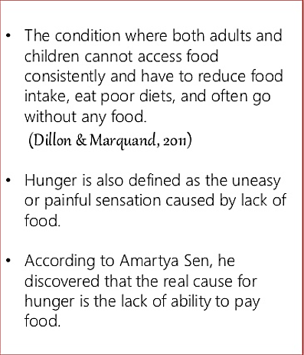
WHAT IS HUNGER ?

Slide 4


Slide 5
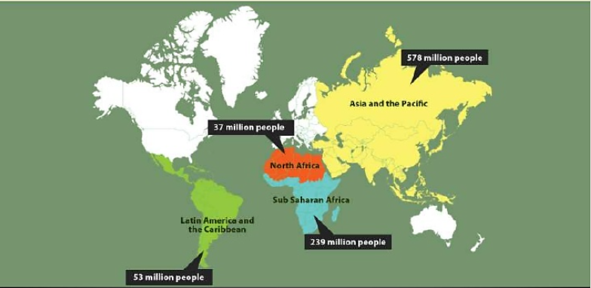
World hunger: A reality check

Slide 6
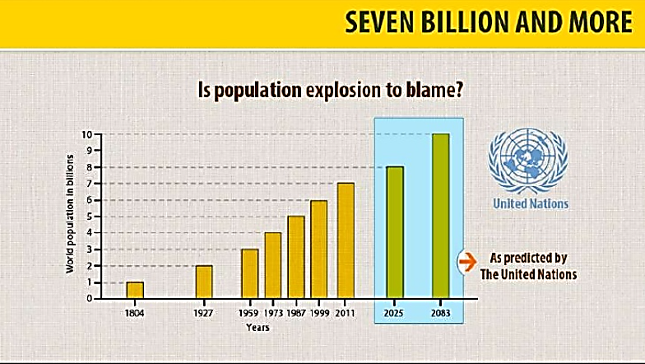
IS POPULATION explosion to blame ?

Slide 7
MOTIVATION
As the world is suffering from one of the disastrous pandemic in the human civilization i.e. N-COV II and in the time of this crisis we thought of providing food to the needy ones such as the migrant laborer and day workers who do not have enough resources to feed themselves and their family.

Slide 8
OBJECTIVE
It will be a non-profit web-based project solving the problem of hunger, food waste and malnutrition. About 67 million tons of food is wasted in India annually valued at Rs.920 billion. So, our objective is to make such a platform where we can solve this problem of hunger and malnutrition by providing food to the needy.

Slide 9
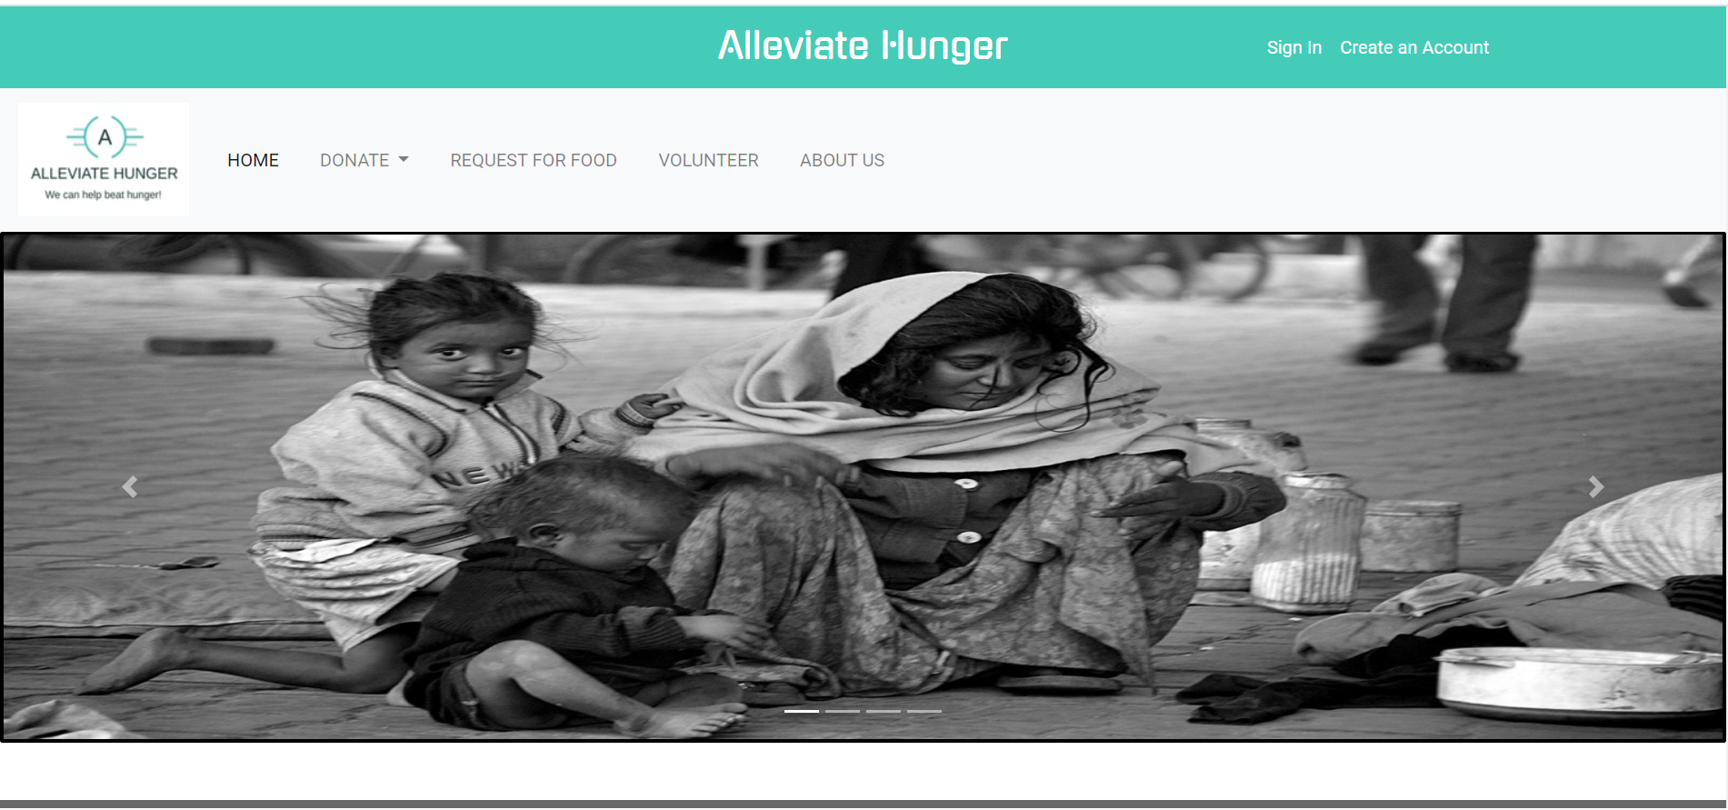
Home page

Slide 10

MODULES
DONATE FOOD
DONATE FUNDS
VOLUNTEER
REQUEST FOR FOOD

Slide 11
DONATE FOOD
In this module a person can donate food by filling up a form where he/she has to provide some necessary details and has to sign up.

Slide 12
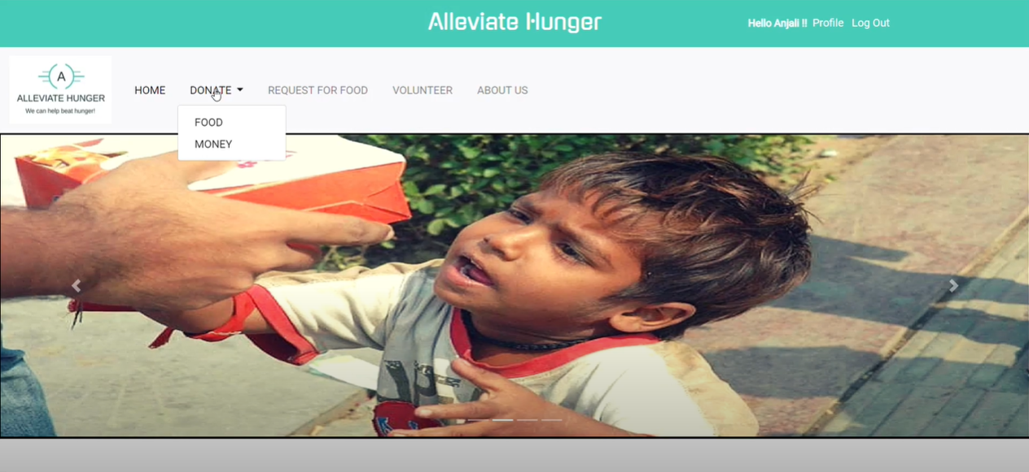
DONATE FOOD

Slide 13
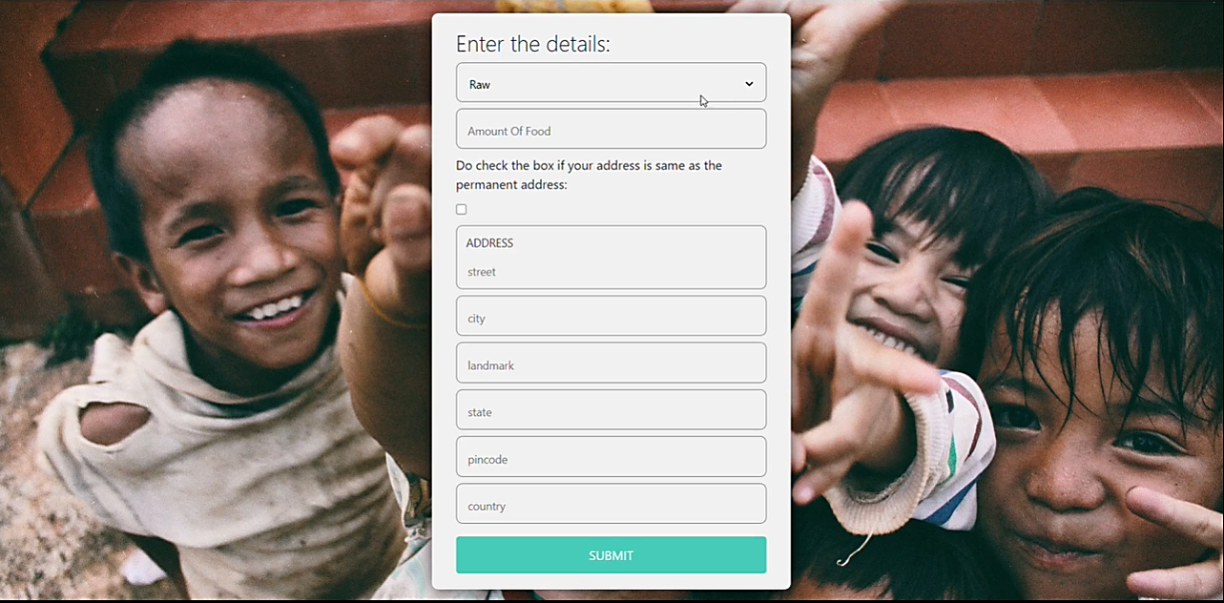
Form for donate food

Slide 14
DONATE FUNDS
A person can support the social service project by providing funds with whatever he/she is willing to.

Slide 15
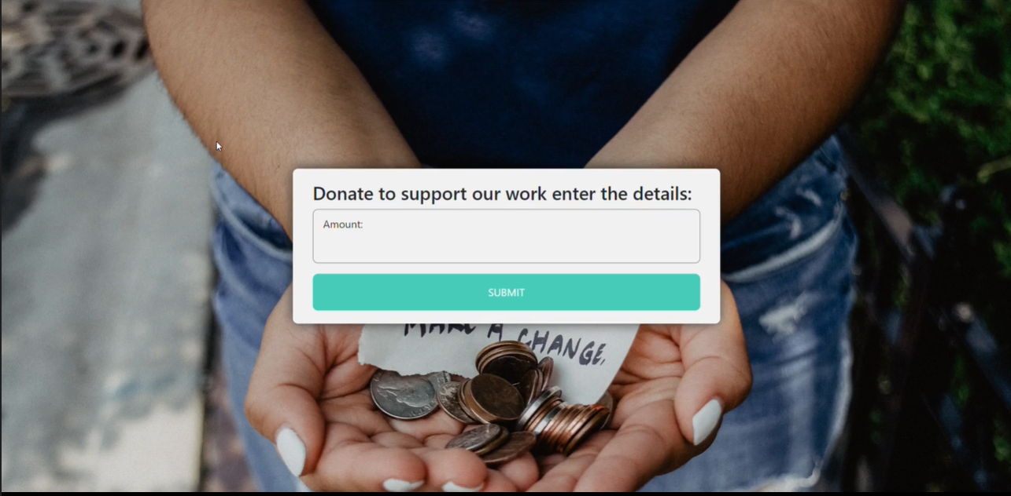
GLIMPSES FROM PROJECT

Slide 16
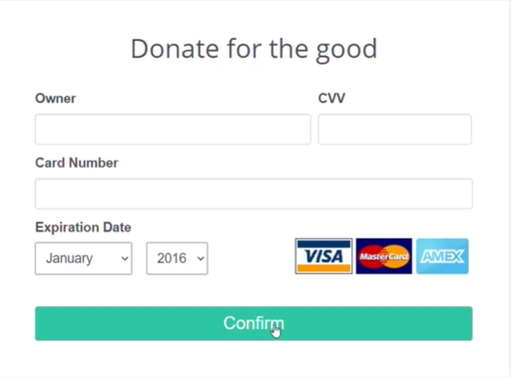
DONATE FOR THE GOOD
THROUGH:
VISA CARD
MASTER CARD
AMERICAN EXPRESS

Slide 17
VOLUNTEER
Those who want to become a part of the program can volunteer by filling up an online form. Timing will be as per your convenience and your help will be very grateful to us.

Slide 18
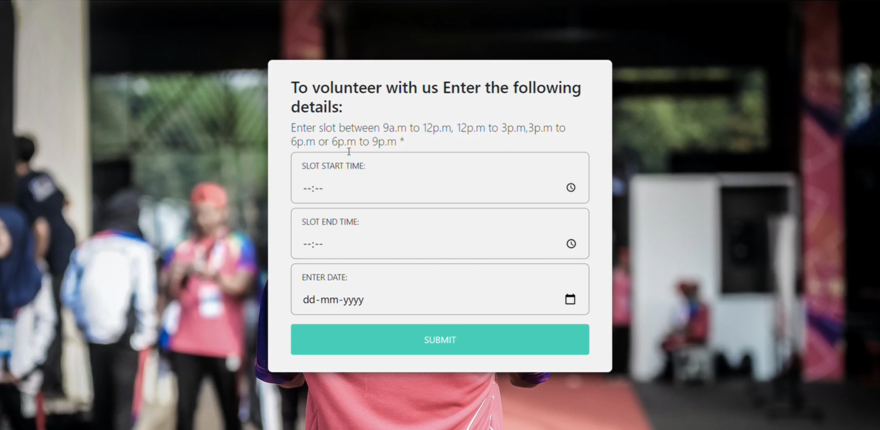
GLIMPSES…

Slide 19
Request for food
Needy People who are in need of food can visit our website and request for food by providing the essential details.
Needy People can ask for raw and prepared food according to his/her requirements.

Slide 20
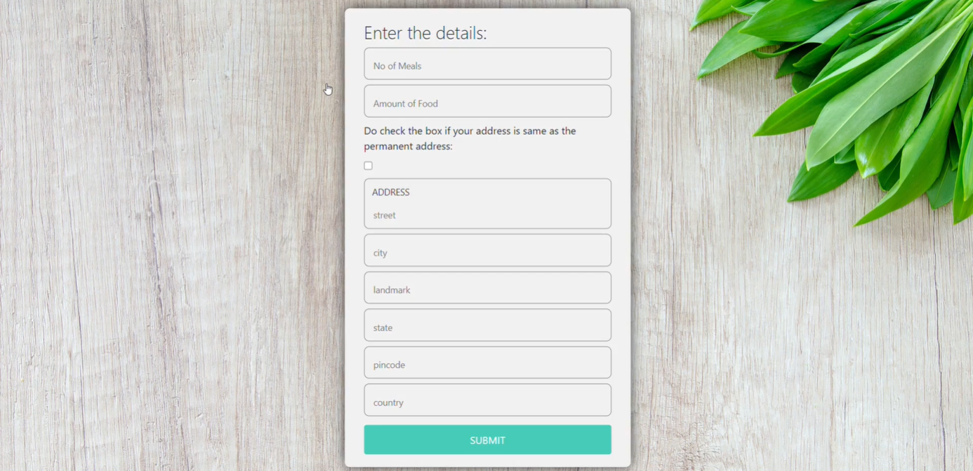
REQUEST FOR FOOD

Slide 21
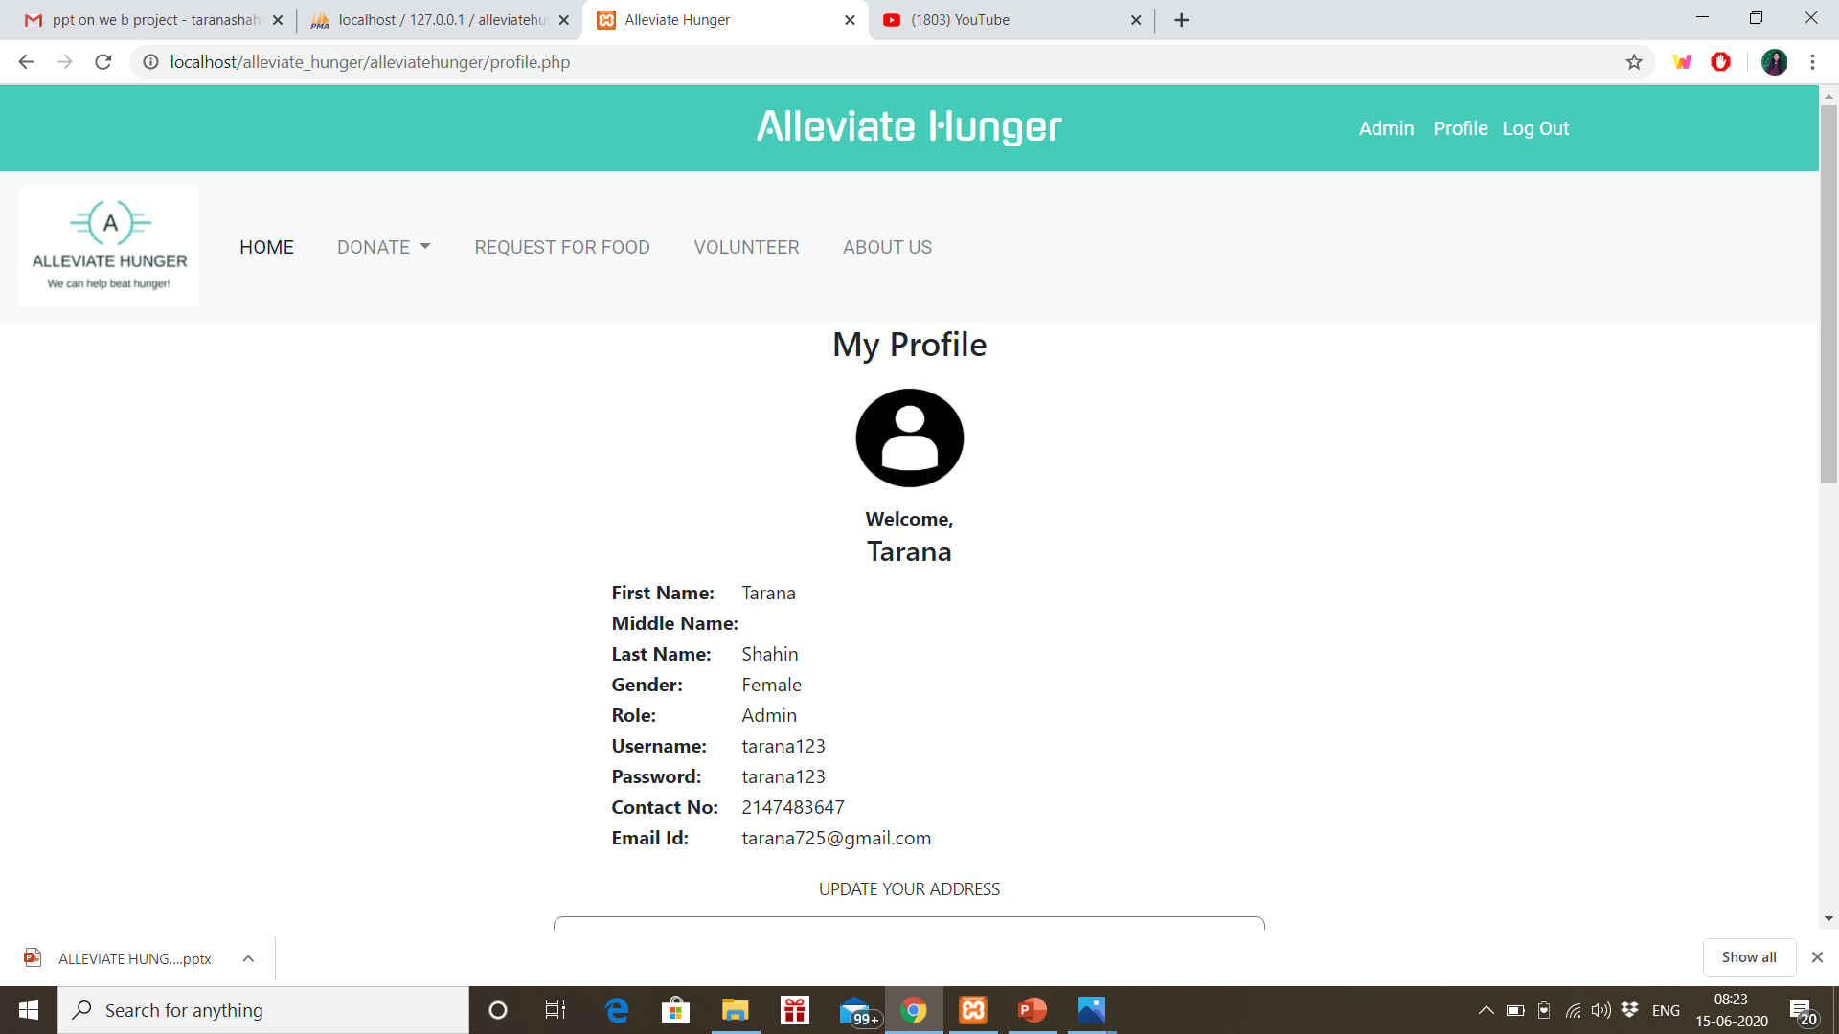
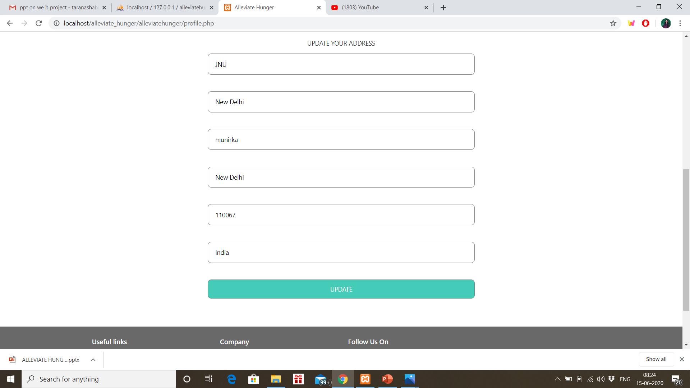
Profile section of user

Slide 22
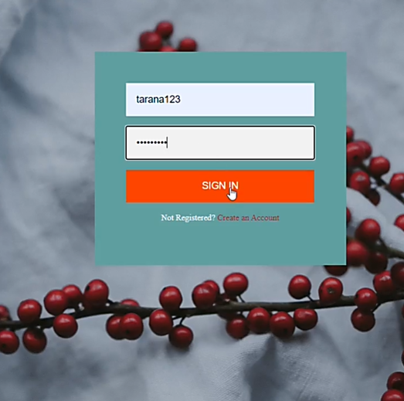
LOG IN MODULE
In this module we can login and see the details as a volunteer/donator/needy people. We can login using the authenticated username and password.

Slide 23
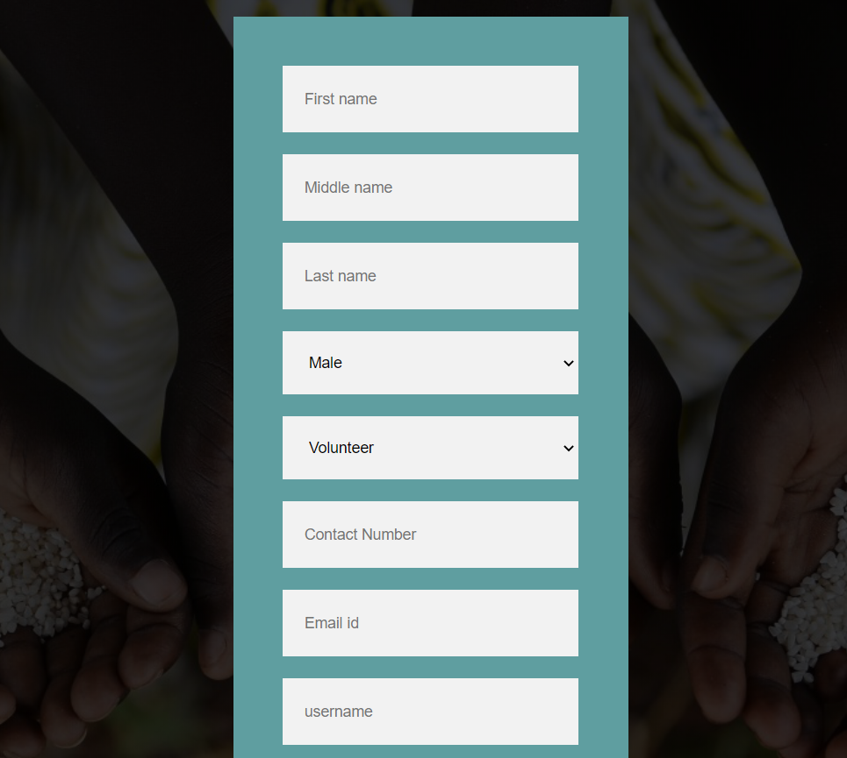
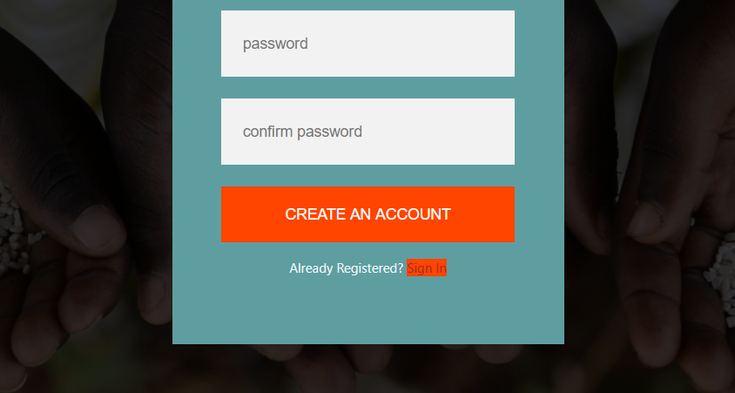
Registration form
Any one who is willing to contribute can become donator by filling up this form.
Those who want to volunteer can volunteer with us by filling up the form.
Those who are in need of food can register as needy people and get the food delivered at your doorstep.

Slide 24
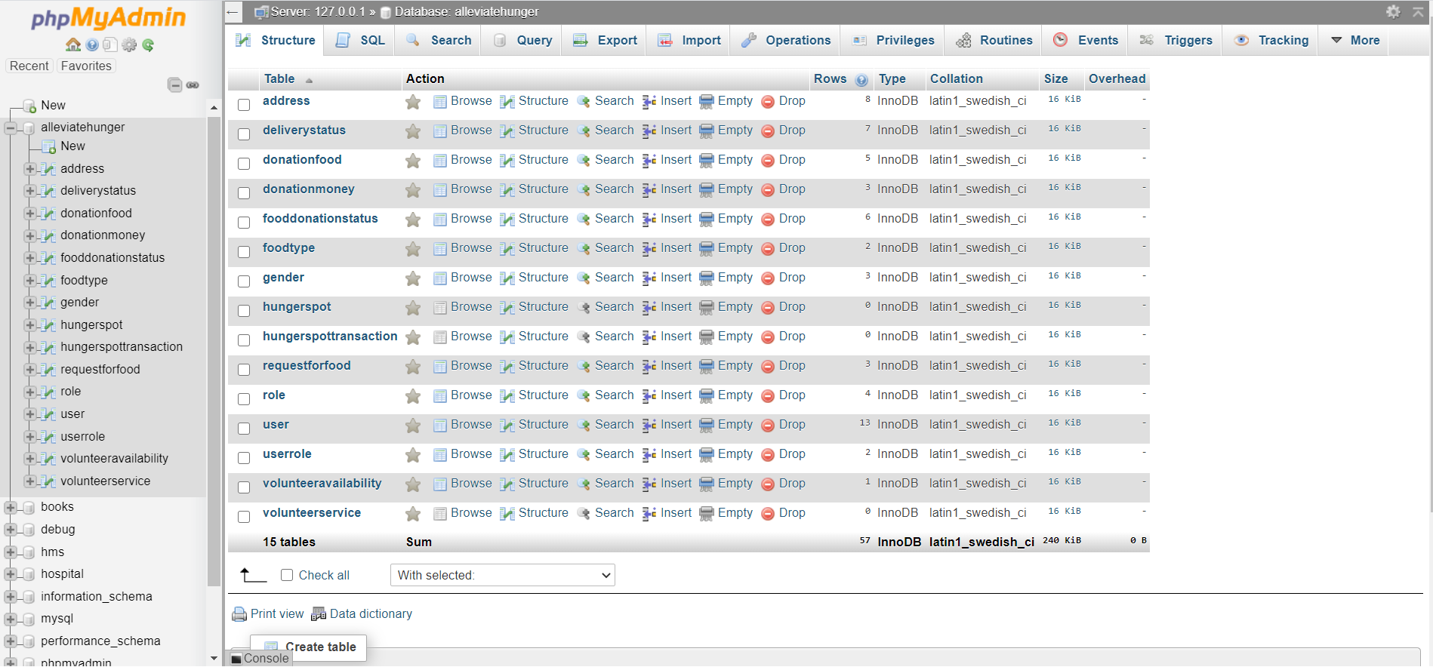
Glimpse of the database

Slide 25
Admin section
Admin can see all the details as how much meals have been donated so far, how much donation has come.
Admin can also who are the people who have requested for food and can contact them made the food delivered.
In admin section one admin can give access to another person and can make him admin.

Slide 26
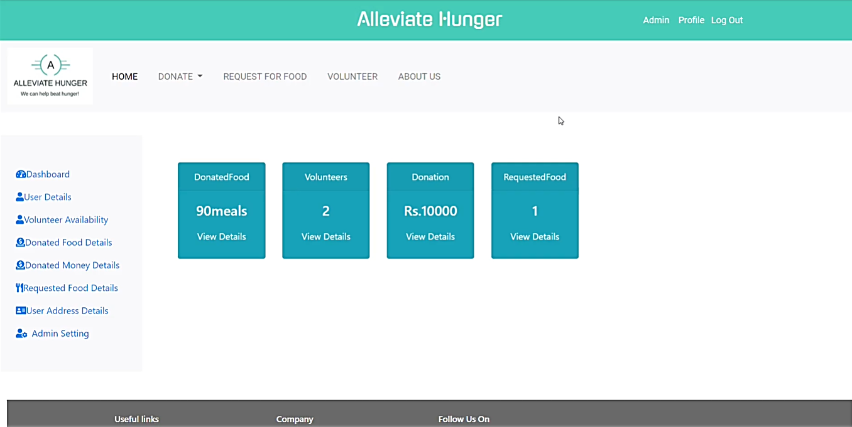
ADMIN MODULE

Slide 27
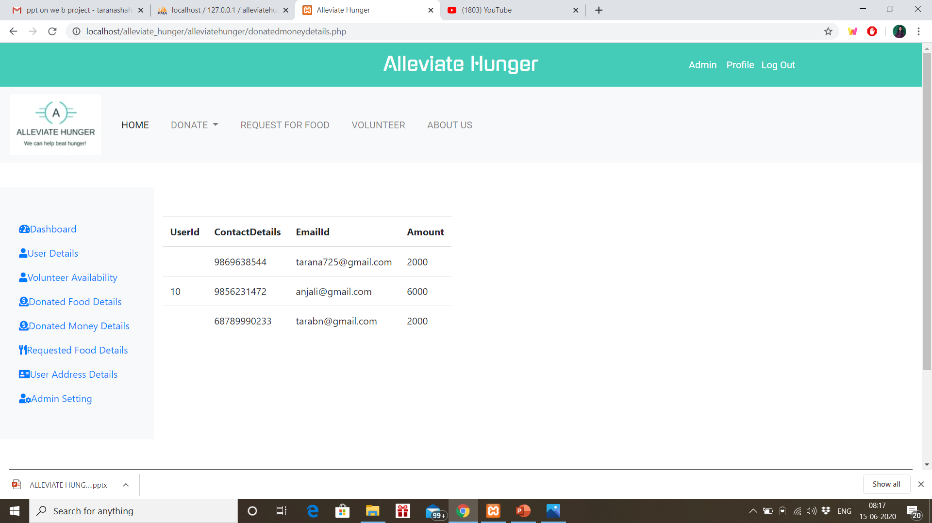
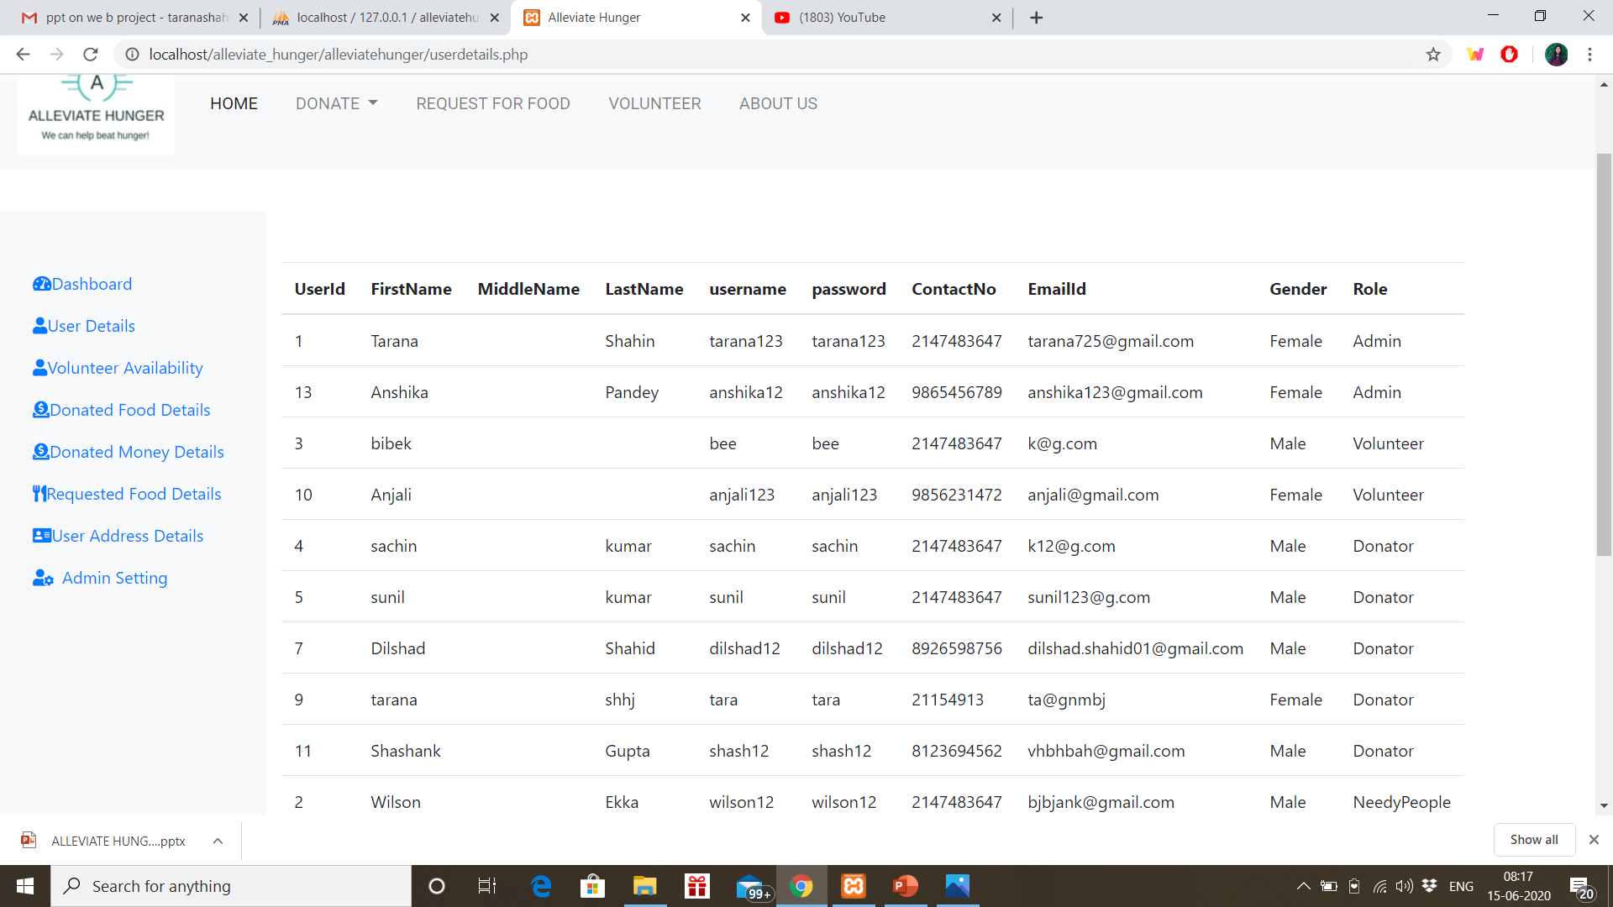
Glimpses of admin module

Slide 28
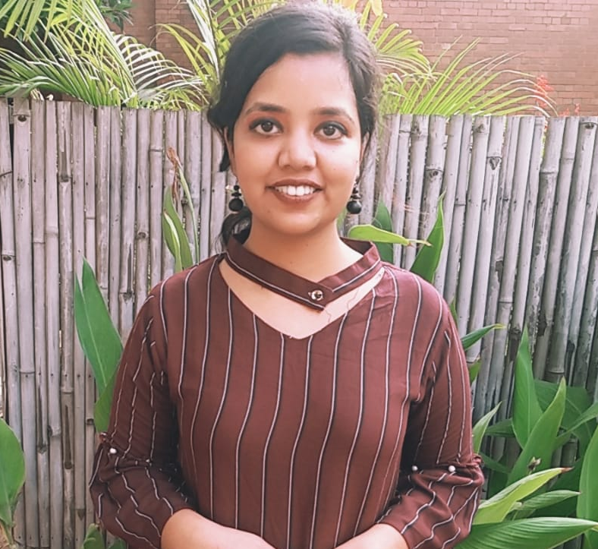
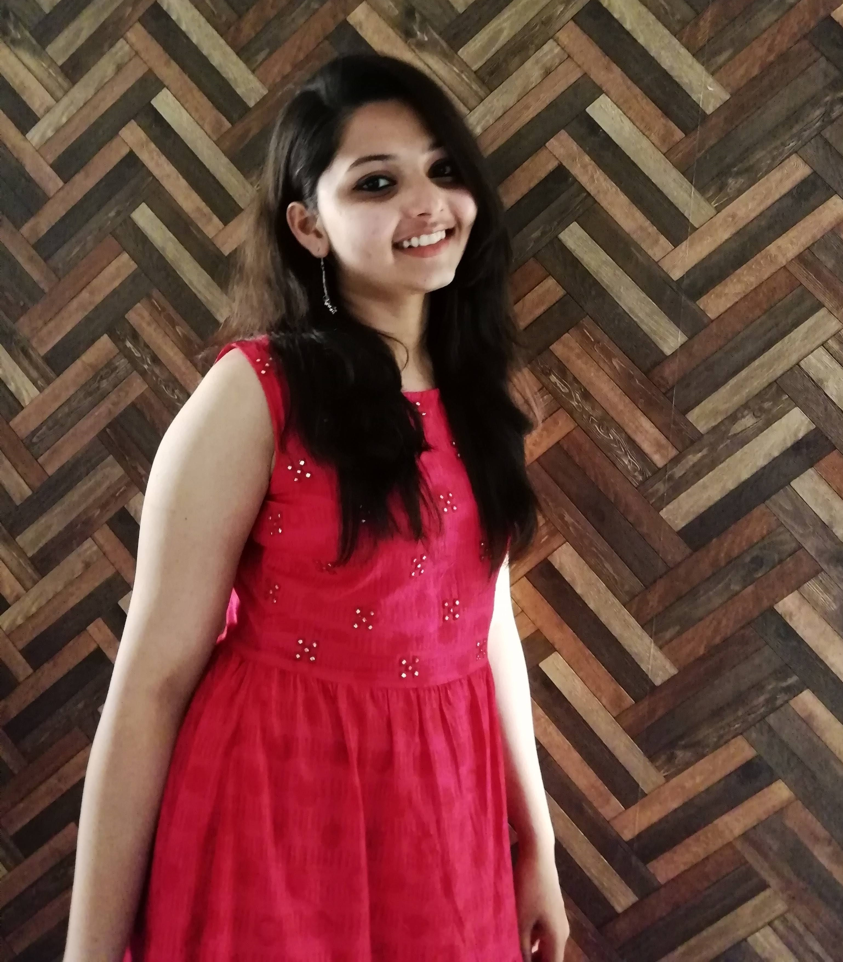
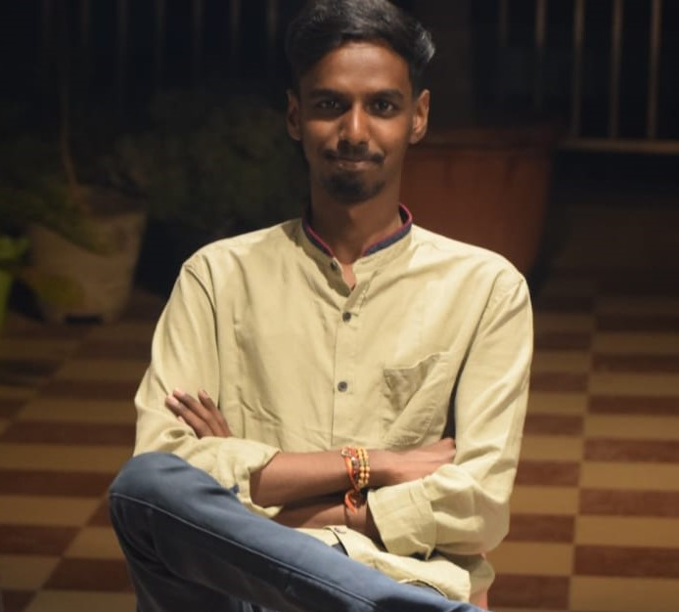
Behind the project
TARANA SHAHIN
ANJALI
SHASHANK GUPTA

Slide 29


